Slide 1
SOLID Design Principles
Instructor: Mehroze Khan

Slide 2
SOLID Principles
Good software systems begin with clean code
The SOLID principles tell us how to arrange our functions and data structures into classes, and how those classes should be interconnected
The goal of the principles is the creation of mid-level software structures that:
Tolerate change
Are easy to understand
Are the basis of components that can be used in many software systems
The term “mid-level” refers to the fact that these principles are applied by programmers working at the module level.

Slide 3
SOLID Principles
SRP: Single Responsibility Principle
OCP: Open-Closed Principle
LSP: Liskov Substitution Principle
ISP: Interface Segregation Principle
DIP: Dependency Inversion Principle

Slide 4
SRP-Single Responsibility Principle
The Single Responsibility Principle states that a class should do one thing and therefore it should have only a single reason to change.
A module should have a reason to change by only one actor.
A module should be responsible to one and only one actor.
Only one potential change (database logic, logging logic, and so on.) in the software’s specification should be able to affect the specification of the class.

Slide 5
Why use SRP?
Many different teams can work on the same project and edit the same class for different reasons, this could lead to incompatible modules.
It makes version control easier. For example, say we have a persistence class that handles database operations, and we see a change in that file in the GitHub commits. By following the SRP, we will know that it is related to storage or database-related stuff.
Merge conflicts are another example. They appear when different teams change the same file. But if the SRP is followed, fewer conflicts will appear – files will have a single reason to change, and conflicts that do exist will be easier to resolve.

Slide 6
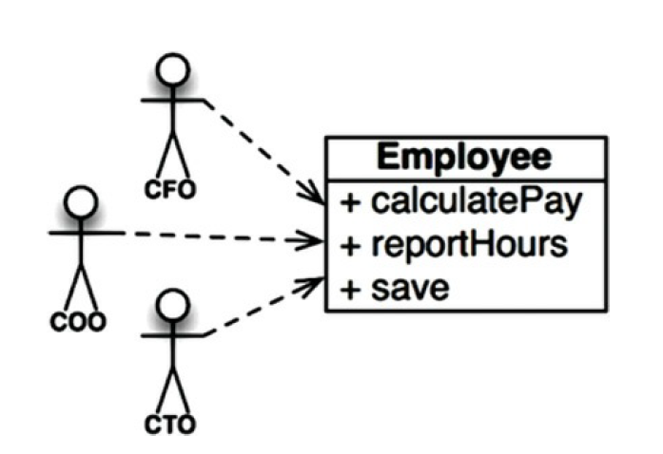
Employee Class from Payroll Application
Employee class from a payroll application has three methods: calculatePay(), reportHours(), and save()
Notes:
CFO (Chief Financial Officer)
COO (Chief Operations Officer)
CTO (Chief Technology Officer)

Slide 7
Employee Class from Payroll Application
This class violates the SRP because those three methods are responsible to three very different actors.
The calculatePay() method is specified by the accounting department, which reports to the CFO.
The reportHours() method is specified and used by the human resources department, which reports to the COO.
The save() method is specified by the database administrators (DBAs), who report to the CTO.
Notes:
CFO (Chief Financial Officer)
COO (Chief Operations Officer)
CTO (Chief Technology Officer)

Slide 8
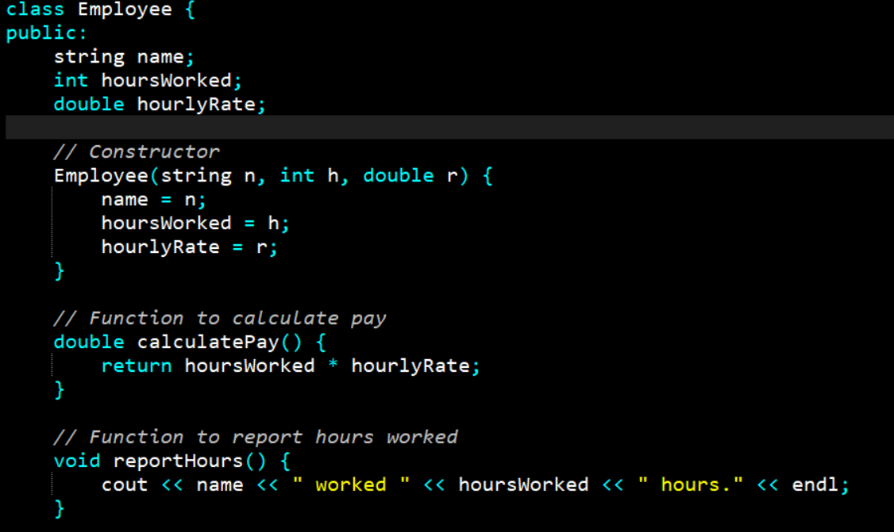

Slide 9
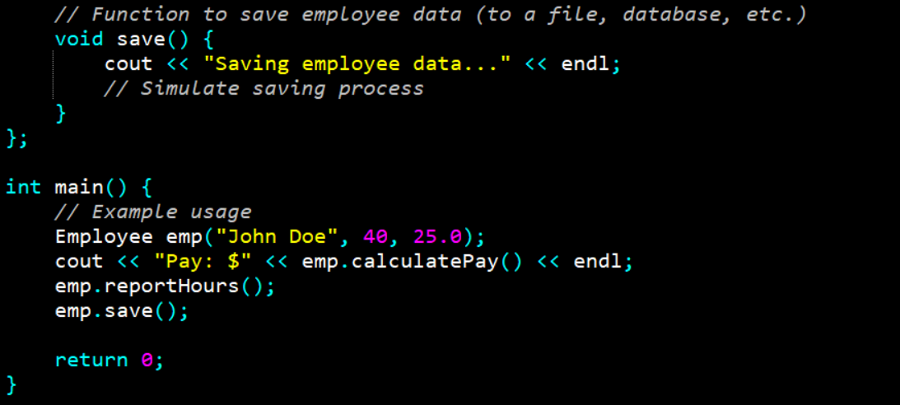

Slide 10
Employee Class from Payroll Application
By putting the source code for these three methods into a single Employee class, the developers have coupled each of these actors to the others.
This coupling can cause the actions of the CFO’s team to affect something that the COO’s team depends on.

Slide 11
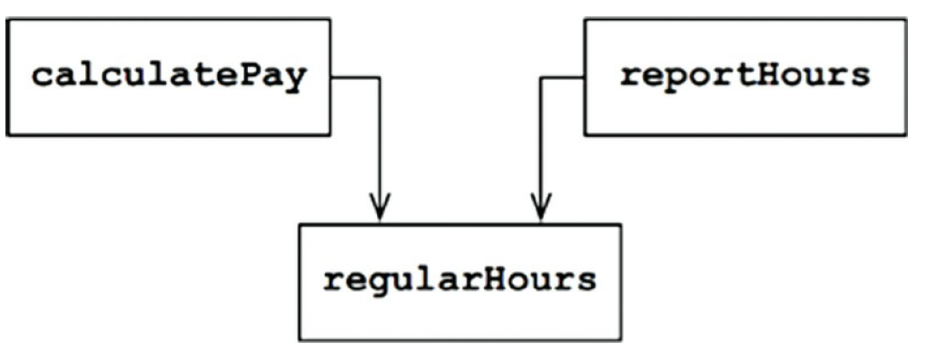
Symptom 1: Accidental Duplication
Suppose that the CFO’s team decides that the way non-overtime hours are calculated needs to be tweaked. In contrast, the COO’s team in HR does not want that tweak because they use non-overtime hours for a different purpose.
A developer is tasked to make the change and sees the convenient regularHours() function called by the calculatePay() method. Unfortunately, that developer does not notice that the function is also called by the reportHours() function.
The developer makes the required change and carefully tests it. The CFO’s team validates that the new function works as desired, and the system is deployed.
Of course, the COO’s team doesn’t know that this is happening. The HR personnel continue to use the reports generated by the reportHours() function—but now they contain incorrect numbers.

Slide 12
Symptom 2: Merges
Suppose that the CTO’s team of DBAs decides that there should be a simple schema change to the Employee table of the database.
Suppose also that the COO’s team of HR clerks decides that they need a change in the format of the hours report.
Two different developers, possibly from two different teams, check out the Employee class and begin to make changes. Unfortunately, their changes collide. The result is a merge.
In our example, the merge puts both the CTO and the COO at risk. It’s not inconceivable that the CFO could be affected as well.
Once again, the way to avoid this problem is to separate code that supports different actors.

Slide 13
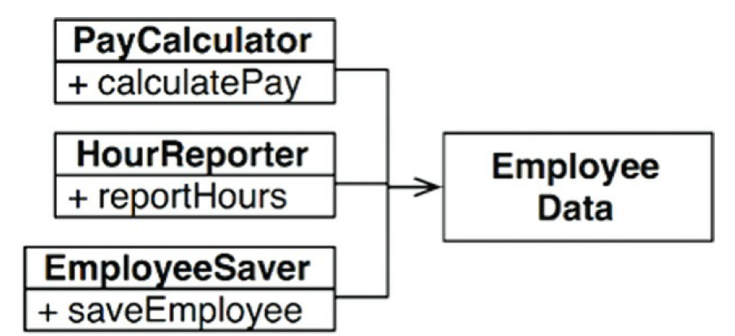
Solution
Most obvious way to solve the problem is to separate the data from the functions.
The three classes share access to EmployeeData, which is a simple data structure with no methods.
Each class holds only the source code necessary for its particular function.
The three classes are not allowed to know about each other. Thus, any accidental duplication is avoided.

Slide 14
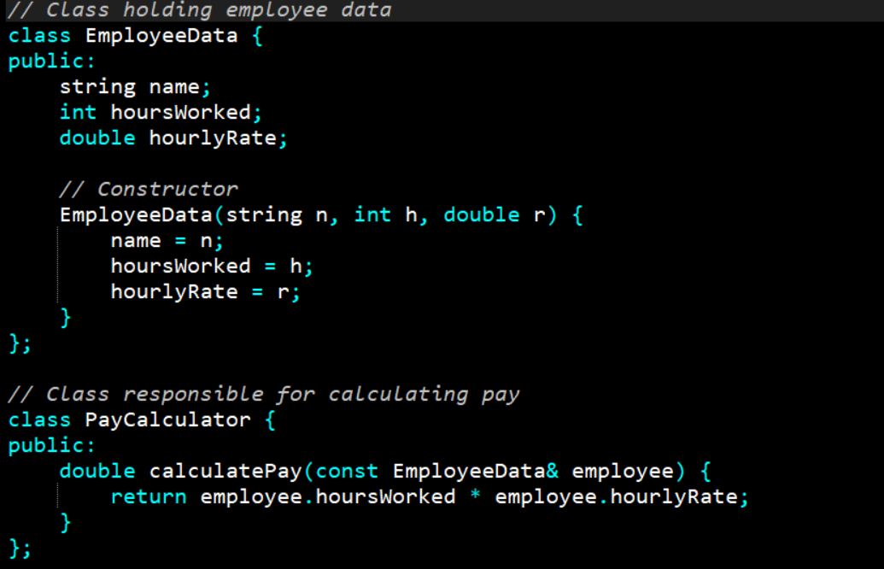

Slide 15
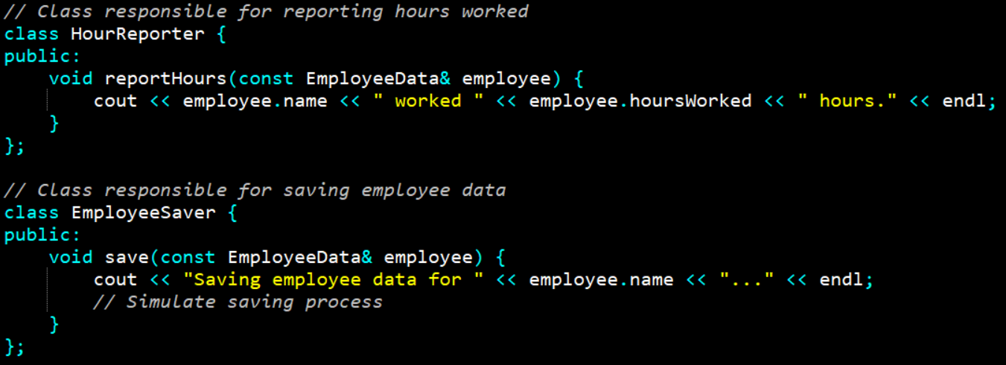

Slide 16
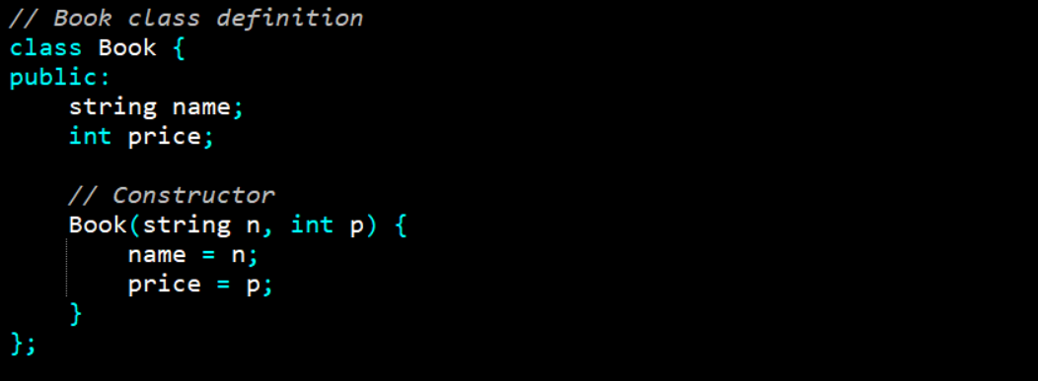
Bookstore Invoice Program

Slide 17
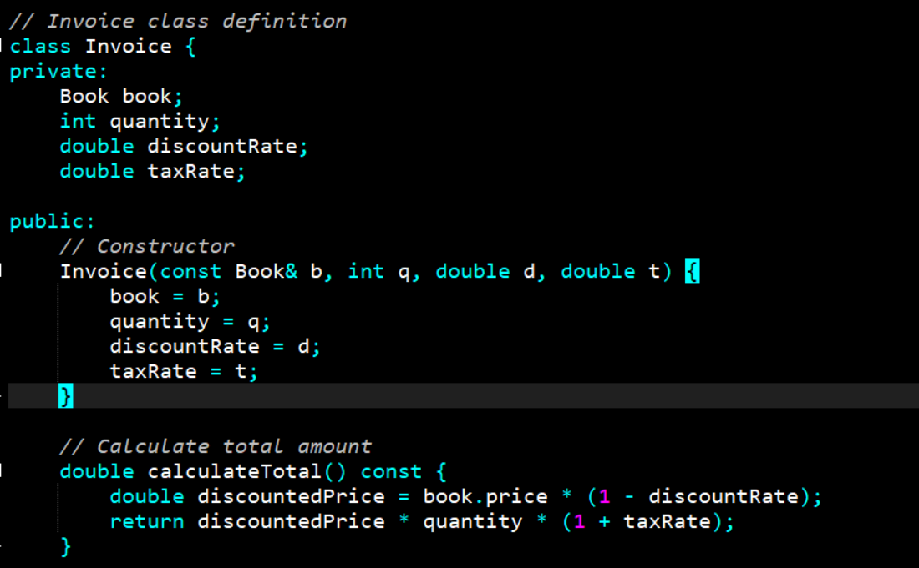

Slide 18
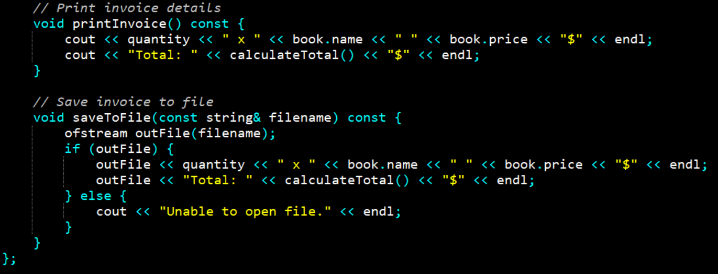

Slide 19
Invoice Class contains some fields about invoicing and 3 methods:
calculateTotal method, which calculates the total price
printInvoice method, that should print the invoice to console
saveToFile method, responsible for writing the invoice to a file
What is wrong with this class design?

Slide 20
Violations of SRP
The first violation is the printInvoice method, which contains our printing logic. The SRP states that our class should only have a single reason to change, and that reason should be a change in the invoice calculation for our class.
But in this architecture, if we wanted to change the printing format, we would need to change the class. This is why we should not have printing logic mixed with business logic in the same class.
There is another method that violates the SRP in our class: the saveToFile method. It is also an extremely common mistake to mix persistence logic with business logic.
Notes:
Persistence logic is concerned with the storage and retrieval of data from a persistent store, such as a database.
Don't just think in terms of writing to a file – it could be saving to a database, making an API call, or other stuff related to persistence.

Slide 21
How to Fix?
We can create new classes for our printing and persistence logic so we will no longer need to modify the invoice class for those purposes.

Slide 22
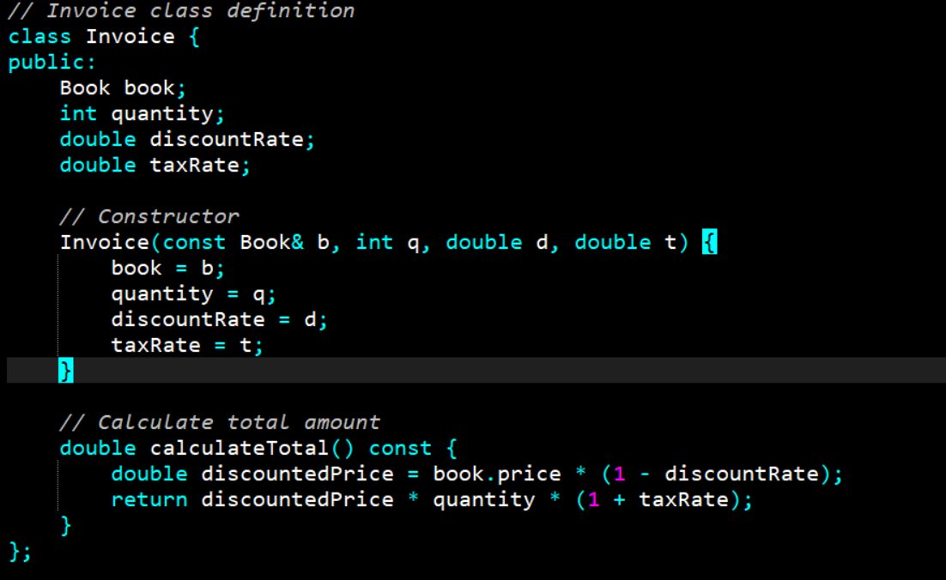
How to Fix?
Notes:
Now our class structure obeys the Single Responsibility Principle and every class is responsible for one aspect of our application.

Slide 23
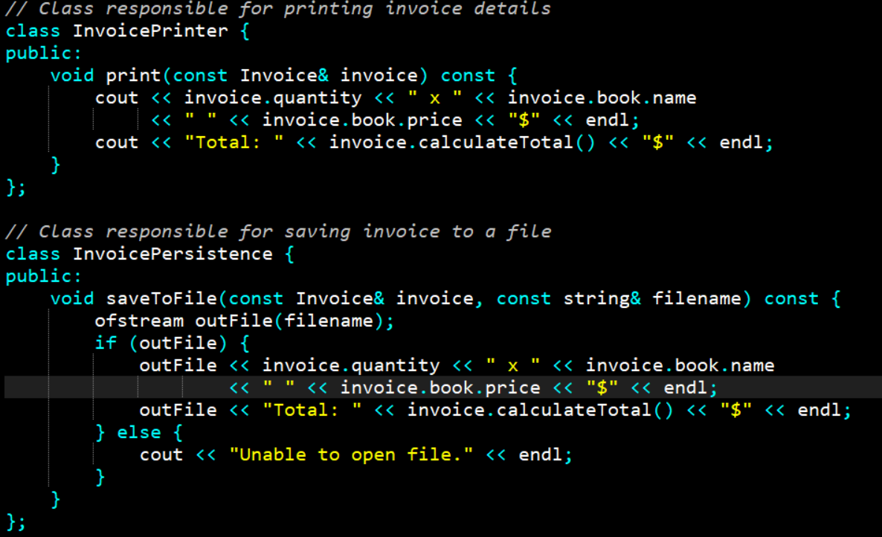
How to Fix?
Notes:
Now our class structure obeys the Single Responsibility Principle and every class is responsible for one aspect of our application.

Slide 24
References
Clean Architecture: A Craftsman's Guide to Software Structure and Design, 1st Edition, Robert C. Martin, Pearson, 2017.

